Slide 1

AMINA HAKIM MOHAMUD
SCREEN TIME DATA ANALYSIS
Notes:
Welcome to the presentation on the analysis of screen time, comparing weekdays and weekends. In this presentation, we will discuss the hypothesis testing results and insights gained from the data.

Slide 2

PROJECT OBJECTIVE
Is your average daily screen time higher on the weekends compared to the weekdays?
Notes:
The main objective of this analysis is to determine whether the average daily screen time is higher on weekends compared to weekdays. By understanding this difference, we can gain insights into screen time habits and patterns.

Slide 3
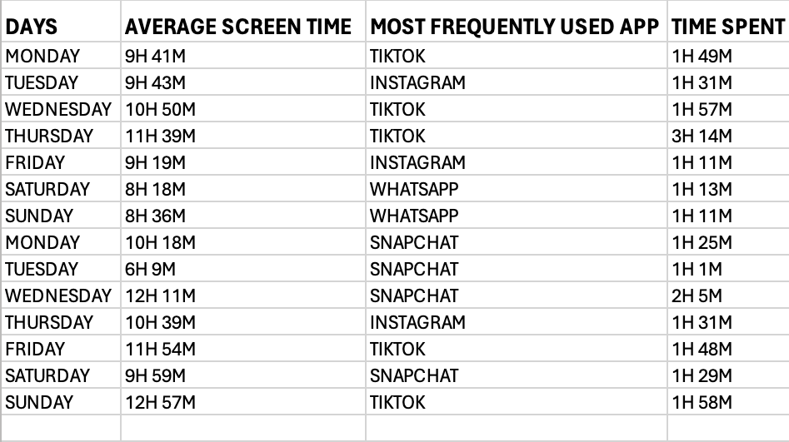
DATA
The following data was collected based on my screen time in the beginning of the month of April.

Slide 4


HYPOTHESIS TESTS
NULL HYPOTHESIS: There is no significant difference between average screen time on weekends VS weekdays.
$$Hθ: μ1−μ2=0$$
ALTERNATIVE HYPOTHESIS: Average weekend screen time is significantly higher than average weekday screen time.
$Hα: μ1 − μ2 >0$
Where:
$μ1:$ Average screen time on weekends
$μ2:$Average screen time on weekdays
Notes:
To test our objective, we have set up two hypotheses. The null hypothesis states that there is no significant difference between average screen time on weekends and weekdays. The alternative hypothesis proposes that the average weekend screen time is significantly higher than the average weekday screen time. We will use statistical methods to determine which hypothesis is supported by the data.

Slide 5
Welch Two Sample t-test Results
Data: weekdays$avg_screen_time_hours and weekends$avg_screen_time_hours
t= 0.46726
p-value= 0.6785
Alternative hypothesis: TRUE difference in means is not equal to 0
Sample estimates:
mean of x (weekdays): 9.70
mean of y (weekends): 9.25
Notes:
We conducted a Welch Two Sample t-test on the data, comparing the average screen time hours on weekdays and weekends. The test results show a t-value of 0.46726, with 2.4599 degrees of freedom. The p-value is 0.6785, which is greater than the commonly assumed significance level of 0.05. The 95 percent confidence interval ranges from -3.033126 to 3.933126. The sample estimates show a mean of 9.70 hours for weekdays and 9.25 hours for weekends.

Slide 6


Interpretation
P-value(0.6785) > assumed significance level ($α=0.05)$
Fail to reject the null hypothesis
There is insufficient evidence to conclude that the average daily screen time is significantly higher on weekends compared to weekdays
Notes:
Interpreting the results, we find that the p-value is greater than the assumed significance level. This means that we fail to reject the null hypothesis. There is insufficient evidence to conclude that the average daily screen time is significantly higher on weekends compared to weekdays.

Slide 7

Additional Findings
Average screen time:
Weekdays: 9.70hours
Weekends: 9.25 hours
Difference is not statistically significant
Notes:
Looking at the data, we see that the average screen time on weekdays is 9.70 hours, while on weekends, it is 9.25 hours. Although there is a slight difference, it is not statistically significant based on the t-test results.

Slide 8
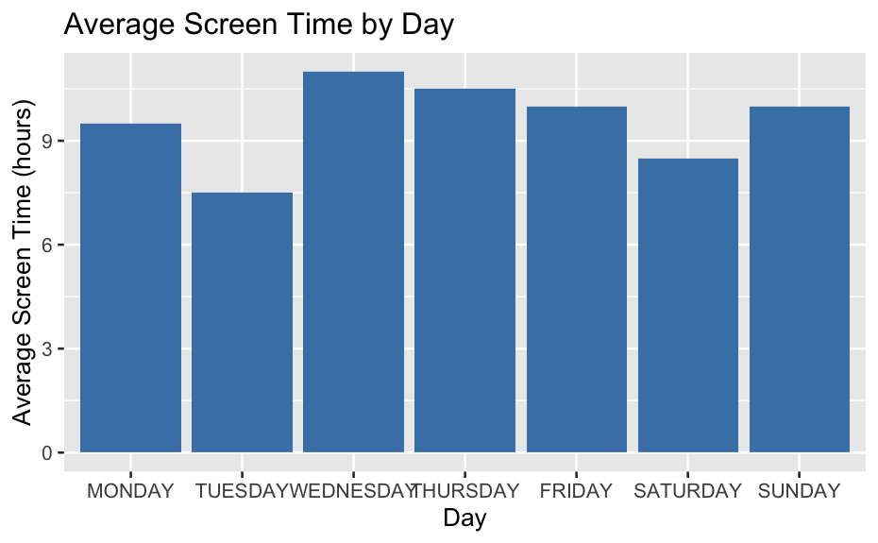
Data Visualization
There is minimal difference between weekdays and weekends
Notes:
To visualise the data, we have created a bar chart showing the average screen time by day. As you can see, the difference between weekdays and weekends is minimal, supporting the t-test results.

Slide 9
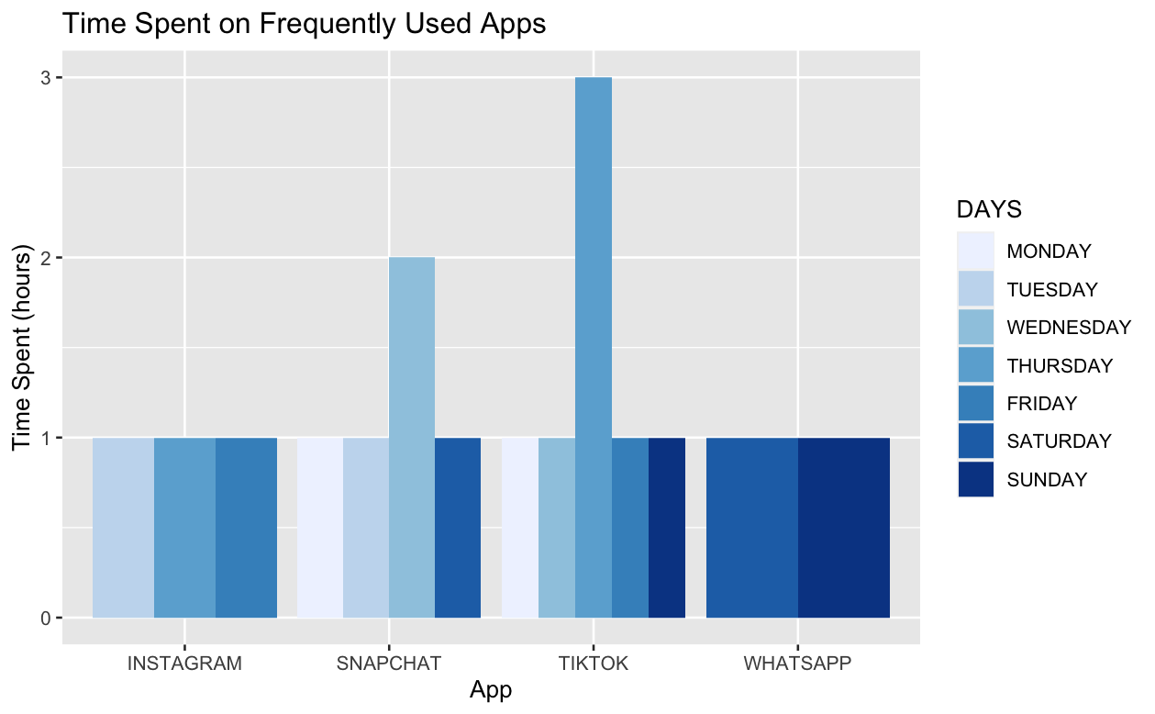
Frequently Used App Analysis
There is notable differences in app usage between weekdays and weekends
Notes:
In addition to analysing overall screen time, we also examined the time spent on frequently used apps. The bar chart on this slide shows the time spent on different apps, broken down by weekdays and weekends. This analysis can provide insights into app usage patterns and any notable differences between weekdays and weekends.

Slide 10
Conclusion
Based on the t-test results, there is no significant difference in average screen time between weekdays and weekends
Further research may be needed to explore other factors influencing screen time habits
Notes:
In conclusion, based on the t-test results, we found no significant difference in average screen time between weekdays and weekends. This suggests that screen time habits may be consistent throughout the week. However, further research may be needed to explore other factors that could influence screen time habits.

Slide 11

Git-hub
https://github.com/aminahakim/SCREEN-TIME-ANALYSIS-

